Slide 1
Introduction
The eigenvalue problem is extremely important in areas such as engineering, physics, chemistry, statistics, and economics, so we need to know how to solve the problem accurately.
Finding the roots of the characteristic polynomial is not acceptable, since the problem of finding roots of polynomials is unstable.

Slide 2
Introduction
Under the right conditions, if λ₁ is the dominant eigenvalue successive powers of A can be used to approximate λ₁. Similarly, if A is nonsingular, successive powers of A⁻¹ will compute λ_{n}.
Application of the QR decomposition is the most commonly used method for computing eigenvalues. We will discuss four algorithms for computing eigenvalues and eigenvectors.

Slide 3
Introduction
Just as there is perturbation theory for solving the linear system Ax=b , there are similar results for the computation of eigenvalues.
Can define a condition number for a particular eigenvalue and use it to estimate the difficulty of computing the eigenvalue.

Slide 4
Vibrations and Resonance
Consider the vibration of two objects of mass m attached to each other and the walls by three springs with spring constant k . There is no damping, and the springs cannot move vertically. A driving force F₀ cos (ω₀) acts on the left mass.

Slide 5
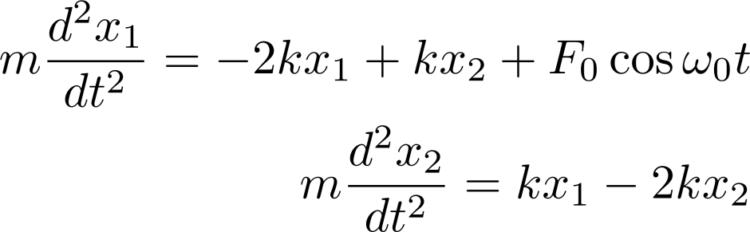
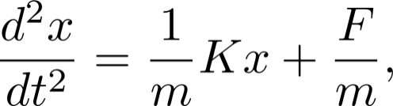
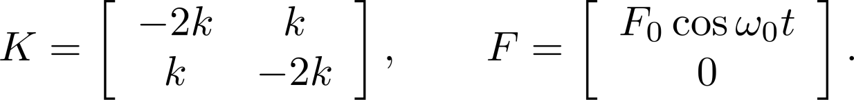
Vibrations and Resonance
The equations of motion for the displacement of the masses are: In matrix form, where

Slide 6
Vibrations and Resonance
Try a solution to the homogeneous equation of the form , and this leads to the eigenvalue problem . The general solution to the homogeneous equation is

Slide 7
Vibrations and Resonance
The frequencies and are known as the natural frequencies of the system. Without a driving force, the system vibrates with these frequencies.
Using the method of undetermined coefficients and complex variables, a particular solution is where

Slide 8
Vibrations and Resonance
The matrix is invertible if If is close to one of these frequencies, is close to singular, and resonance occurs.

Slide 9
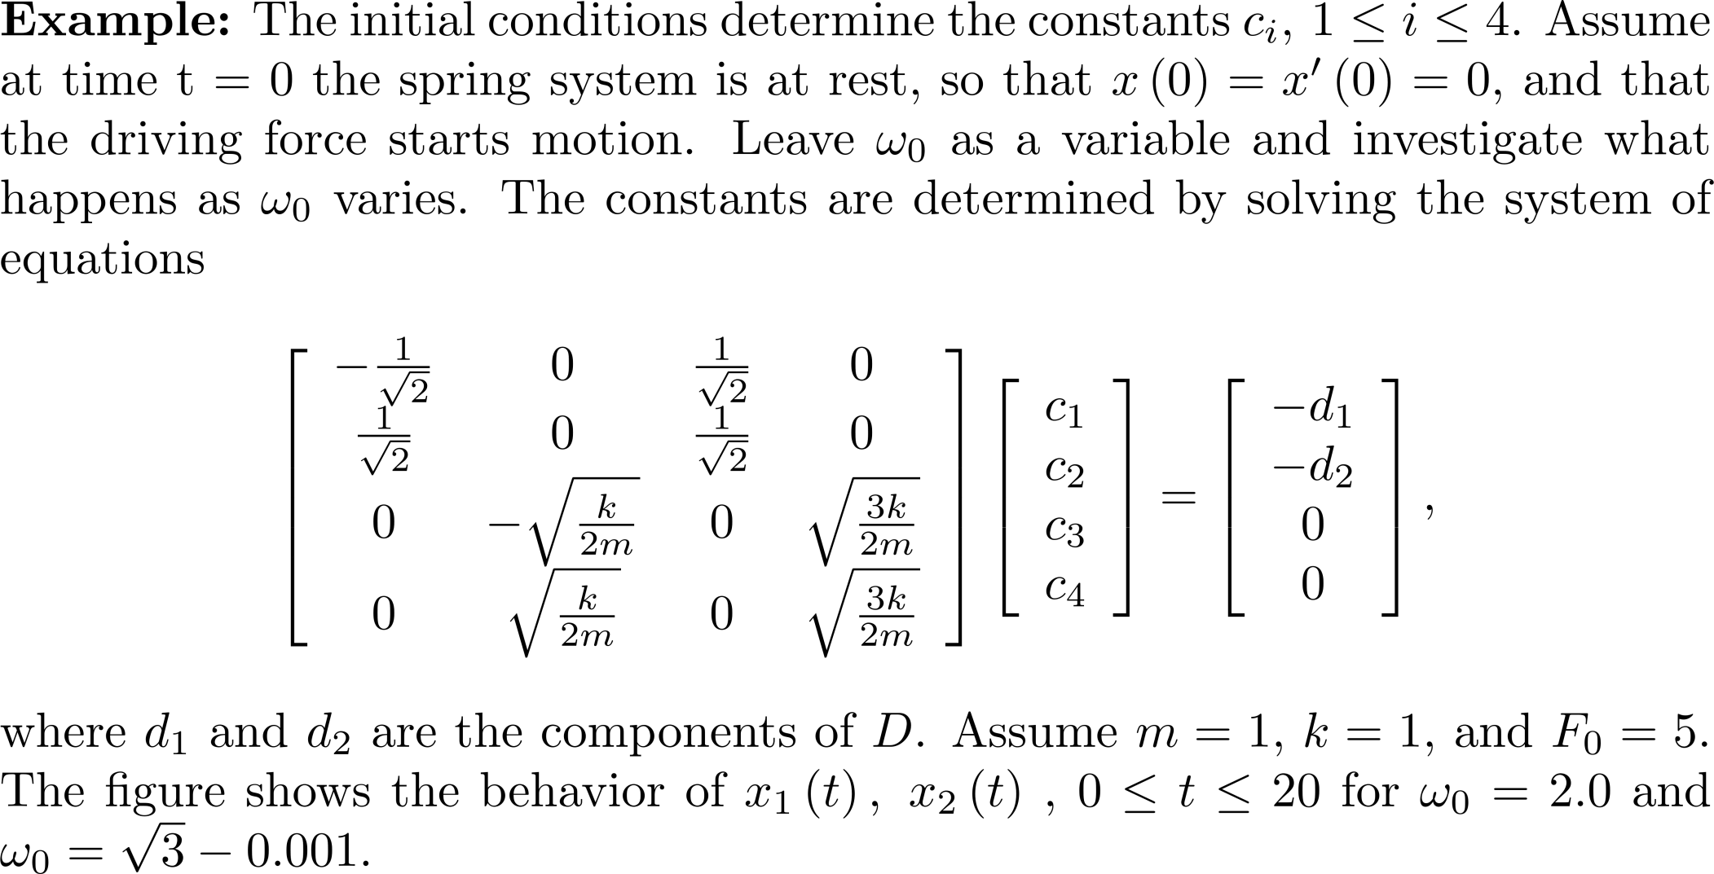
Example 1

Slide 10
Example 1
is close to the natural frequency ,
and resonance occurs.

Slide 11
The Leslie Model in Population Ecology
Given an age-structured population, the Leslie model predicts how distinct populations change over time.
Consider only the females present in the population. There are m age classes, 1, … ,m , where is m is the maximum reproductive age of an individual. The model uses the following parameters for the groups:

Slide 12
The Leslie Model in Population Ecology
Let L be the Leslie matrix
Place all of the n_{i}(t) values into a column vector N(t) of dimension m. Then, which says that we can project into the future by computing matrix powers.

Slide 13
The Leslie Model in Population Ecology
L has a positive dominant eigenvalue and an eigenvector with strictly positive entries. After some analysis, there results the Euler-Lotka equation where l₁ =1 and l_{k} = p₁ p₂ … p_{k-1} for 2 ≤ k ≤ m. The value l_{k} is the fraction of one year olds that survive to age k.

Slide 14
The Leslie Model in Population Ecology
Using the Euler-Lotka equation and assuming that L has m distinct eigenvalues, it follows that where λ₁ is the dominant eigenvalue with associated eigenvector u₁, and c(t) is a vector that varies with t.

Slide 15
The Leslie Model in Population Ecology
As time increases, the age distribution vector tends to a scalar multiple of the eigenvector associated with the largest eigenvalue of the Leslie matrix. In other words, at equilibrium the proportion of individuals belonging to each age class will remain constant, and the number of individuals will increase by λ₁ times each period.

Slide 16
The Leslie Model in Population Ecology
Let so that components of u₁ have the same relative proportions as those in the original eigenvector, and they determine the percentage of females in each age class after an extended period of time.

Slide 17
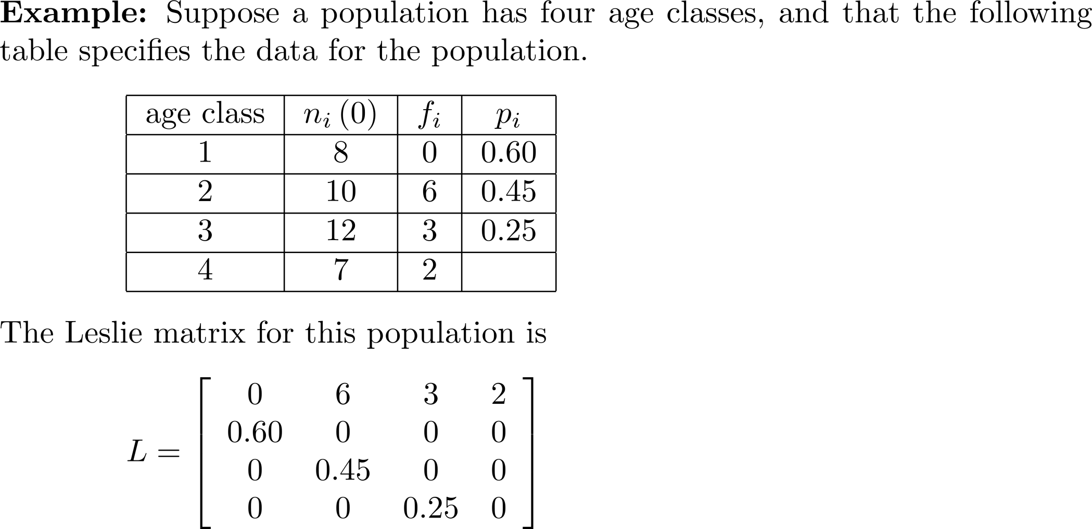
Example 2

Slide 18
Example 2
Using MATLAB, the dominant eigenvalue is λ₁ = 2.0091, and The number of individuals at equilibrium will increase by 2.0091 each time period. The percentage of females in each age class after an extended period of time is given by the components of u₁.

Slide 19
Example 2

Slide 20
Buckling of a Column
Apply a compressive axial force, or load, P, to the top of a vertical thin elastic column of uniform cross section having length L. The column will buckle, and the deflection y(x) satisfies the differential equation where E is Young's modulus of elasticity and I is the area moment of inertia of the column cross section.

Slide 21
Buckling of a Column
Assume that the column is hinged at both ends so that y(0)=y(L)=0 , and we have the boundary value problem
y=0 is a solution to the problem, and this corresponds to the situation where the load P is not large enough to cause deflection. Determine values of P that cause the column to buckle; in other words, for what values of P does the boundary value problem have nontrivial solutions?

Slide 22
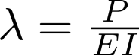
Buckling of a Column
If , the nontrivial solution is
are the critical loads. The column will buckle only when the compressive force is one of these values.
Eigenfunctions

Slide 23
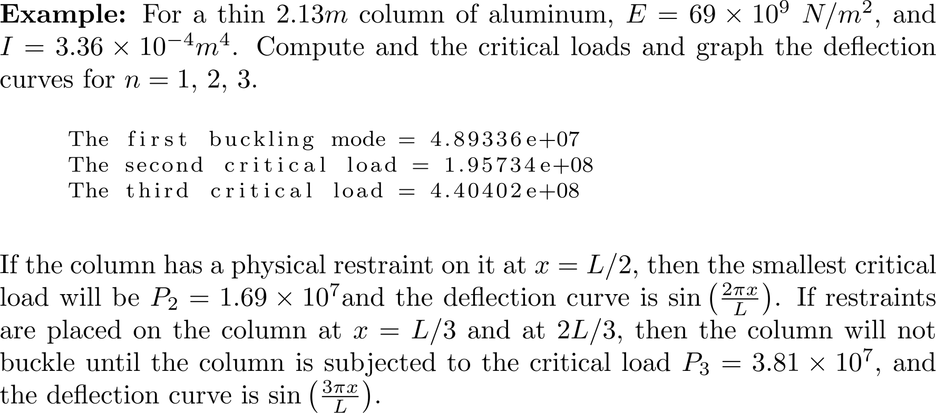
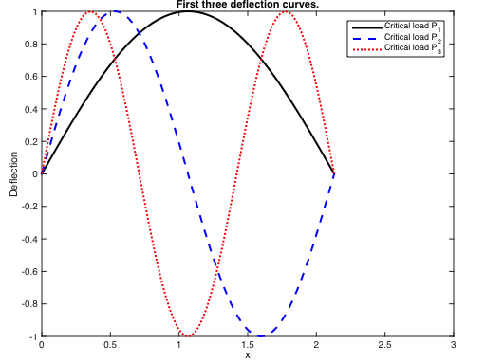
Example 3

Slide 24
Computation of Selected Eigenvalues and Eigenvectors
In some applications, it is only necessary to compute a few of the largest or the smallest eigenvalues and their corresponding eigenvectors. Examples include:
The Leslie matrix.
The buckling problem. The most important eigenvalue is the smallest.
Vibration of structures. The most important eigenvalues are a few of the smallest ones.
Statistical applications. Only the first few of the largest eigenvalues need to be computed.

Slide 25
The Rayleigh Quotient
Let v be an eigenvector of A. Then,
This is the Rayleigh quotient and is used with the power and inverse power methods to compute an eigenvalue given an eigenvector.

Slide 26
The Dominant Eigenvalue
If eigenvalue λ₁ is such that λ₁ is called the dominant eigenvalue.
If v_{d} is an eigenvector of the dominant eigenvalue, the eigenvalue is

Slide 27
The Dominant Eigenvalue
Not all matrices have a dominant eigenvalue.
The matrix has eigenvalues λ₁ = λ₂ = 2, λ₃ = 1

Slide 28
Additional Property of a Diagonalizable Matrix

Slide 29
Example 4
Perform a numerical experiment with a 4 × 4 matrix A having a dominant eigenvalue. Start with the vector, compute v = A*v and then normalize v. Repeat the process a total of 25 times and compute the Rayleigh quotient.

Slide 30
Example 4
>> v = ones(4,1);
>> for i = 1:25
v = A*v;
v = v/norm(v);
end
>> v
v =
-0.7768
0.0400
0.1076
0.6192
>> rayleighquot = (v'*(A*v))/(v'*v)
rayleighquot =
-24.0862
>> eig(A)
ans =
-24.0858
-16.0365
11.1223
10.0000
NOTE: The Rayleigh quotient is close to the dominant
eigenvalue.
The dominant eigenvalue.

Slide 31
The Power Method for Computing the Dominant Eigenvalue
If v₀ is an initial vector, A is diagonalizable, and A has a dominant eigenvalue, then the sequence converges to the eigenvector corresponding to the dominant eigenvalue.
The rate of convergence is determined by the ratio , where λ₂ is the second largest eigenvalue. The power method will converge quickly if is small and slowly if is close to 1.

Slide 32
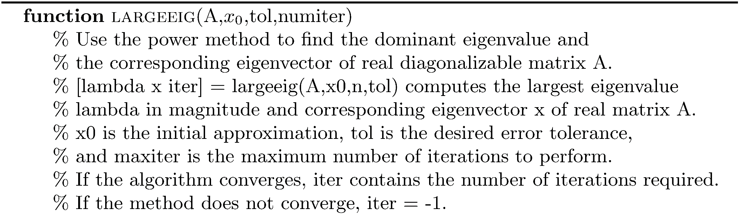
The Power Method

Slide 33
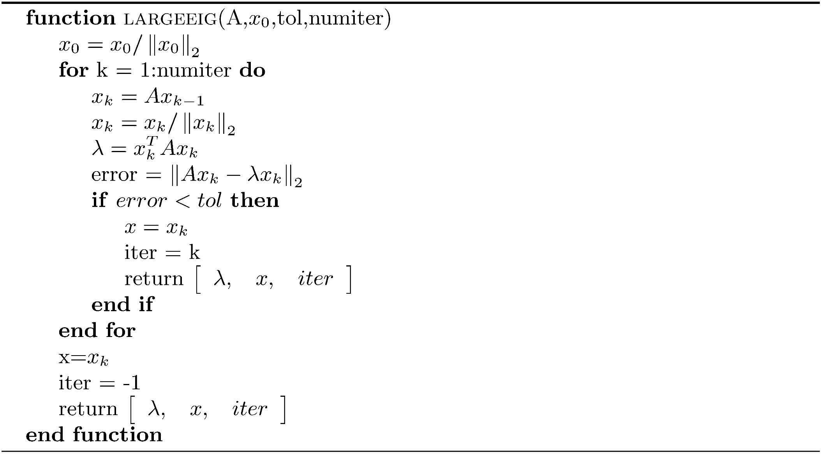
The Power Method (concluded)

Slide 34
Example 5
Create a matrix A with known eigenvalues, one of which is dominant, verify that it is diagonalizable, compute the dominant eigenvalue using the power method, and compare it to the eigenvalue found using MATLAB.

Slide 35
Example 5
powermthdtest.m
% eigenvalues 41, 36, -36, -26, 24
A = [-24 -24 5 1 -32;0 -36 -36 -10 -26;0 0 36 -43 -8;
0 0 0 -26 -45;0 0 0 0 41];
B = rand(5,5);
[Q,R] = qr(B);
C = Q'*A*Q % similar matrices have the same eigenvalues
[V,D] = eig(C);
norm(V*D*inv(V)-C) % C is diagonalizable
E = eig(C) % the eigenvalues of C
domeig = max(abs(E));
% estimate the dominant eigenvalue using the power method
[lambda1,v,iter] = largeeig(A,ones(5,1),1.0e-12,250);
fprintf('abs(lambda1-domeig) = %.8e\n',abs(lambda1-domeig));
NOTE:
so expect slow convergence.
Run:
C =
-40.9781 -31.0810 -4.6313 -21.5753 -4.5851
11.7050 34.7393 -7.4443 36.2672 -19.6448
2.9259 18.4741 -14.8756 -27.6542 -0.4782
-6.6090 -5.8369 -8.9187 7.8927 26.0999
-45.3991 -24.7993 -32.3728 30.4716 4.2217
ans =
2.3212e-13
E =
41.0000
36.0000
-36.0000
-26.0000
-24.0000
abs(lambda1-domeig) = 1.13686838e-13

Slide 36
The Inverse Power Method
If A is invertible, A and A⁻¹ have the same eigenvectors and the eigenvalues of A⁻¹ are the reciprocals of those for A.
Assume The dominant eigenvalue of A⁻¹ is .
The power iteration is but A⁻¹ should not be computed. Find the LU decomposition for A and repeatedly solve using forward and back substitution.

Slide 37
Example 6
This problem constructs a matrix with known eigenvalues by generating a random integer matrix, zeroing-out all the elements from the diagonal and below using triu, and then adding a diagonal matrix containing the eigenvalues. There is an eigenvalue, 9, of largest magnitude with multiplicity three, and a smallest eigenvalue in magnitude, -1, well-separated from the others. As expected, the power method fails, and the inverse power method is successful.

Slide 38
Example 6
>> A = randi([-100,100],10,10);
>> A = triu(A,1);
>> d = [-1 3 5 9 9 9 6 2 -7 4]';
>> A = A + diag(d);
>> iterations = [50 100 1000 10000];
>> for i = 1:length(iterations)
[lambda,v,iter] = largeeig(A,ones(10,1),1.0e-10,iterations(i));
lambda
iter
end
lambda =
9.471799775358845
iter =
-1
lambda =
9.204649150708208
iter =
-1
lambda =
9.018221954378124
iter =
-1
lambda =
9.001802197342364
iter =
-1
>> [lambda,v,iter] = smalleig(A,rand(10,1),1.0e-14,75);
>> lambda
lambda =
-1.000000000000044
>> iter
iter =
52

Slide 39
The Basic QR Iteration
Assume that
The matrix is invertible and diagonalizable.
The basic QR iteration is simple to perform:

Slide 40
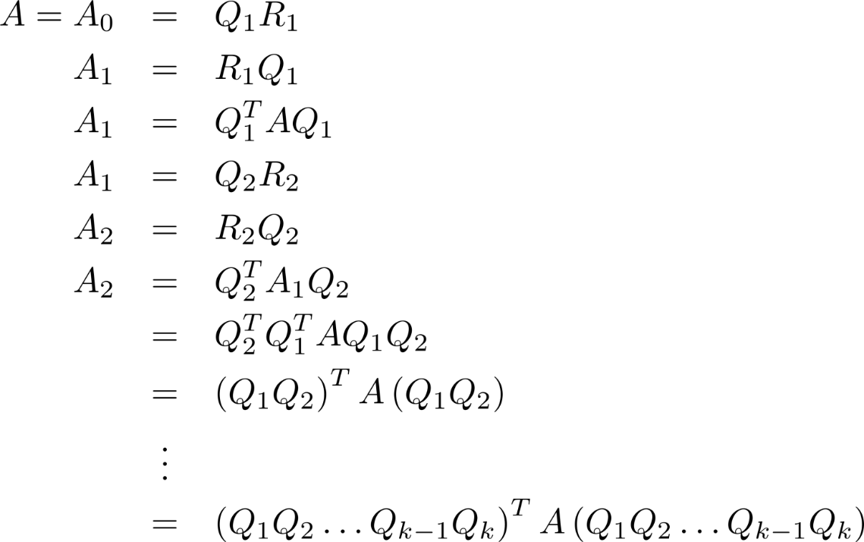
The Basic QR Iteration
Note the following algebra:
is an orthogonal matrix, and

Slide 41
The Basic QR Iteration
Note the following numerical experiment:
>> B = A;
>> for i = 1:35
[Q,R] = qr(A);
A = R*Q;
end
>> A
A =
18.4638 8.4154 -1.2732
-0.0000 5.3457 4.1904
0.0000 -0.0000 -3.8095
>> eig(B)
ans =
18.4638
5.3457
-3.8095

Slide 42
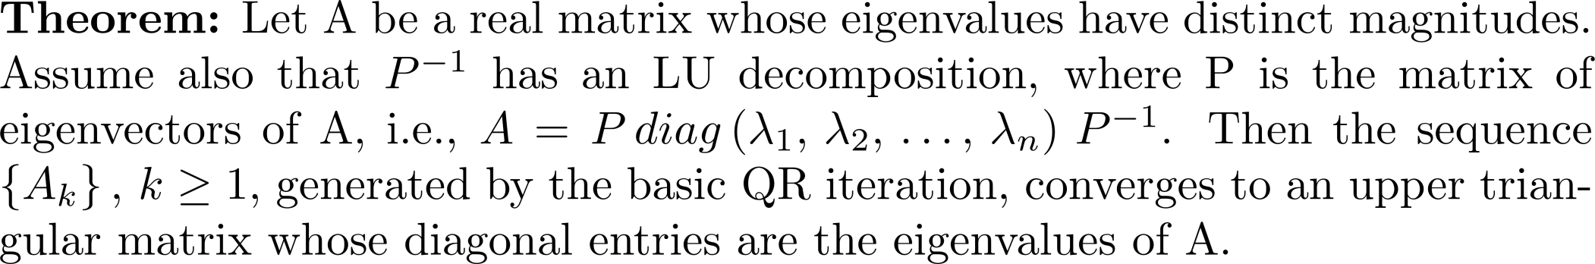
The Basic QR Iteration

Slide 43
Orthogonal Similarity Transformation
NOTE: The basic QR iteration is a orthogonal similarity transformation to upper triangular form.

Slide 44
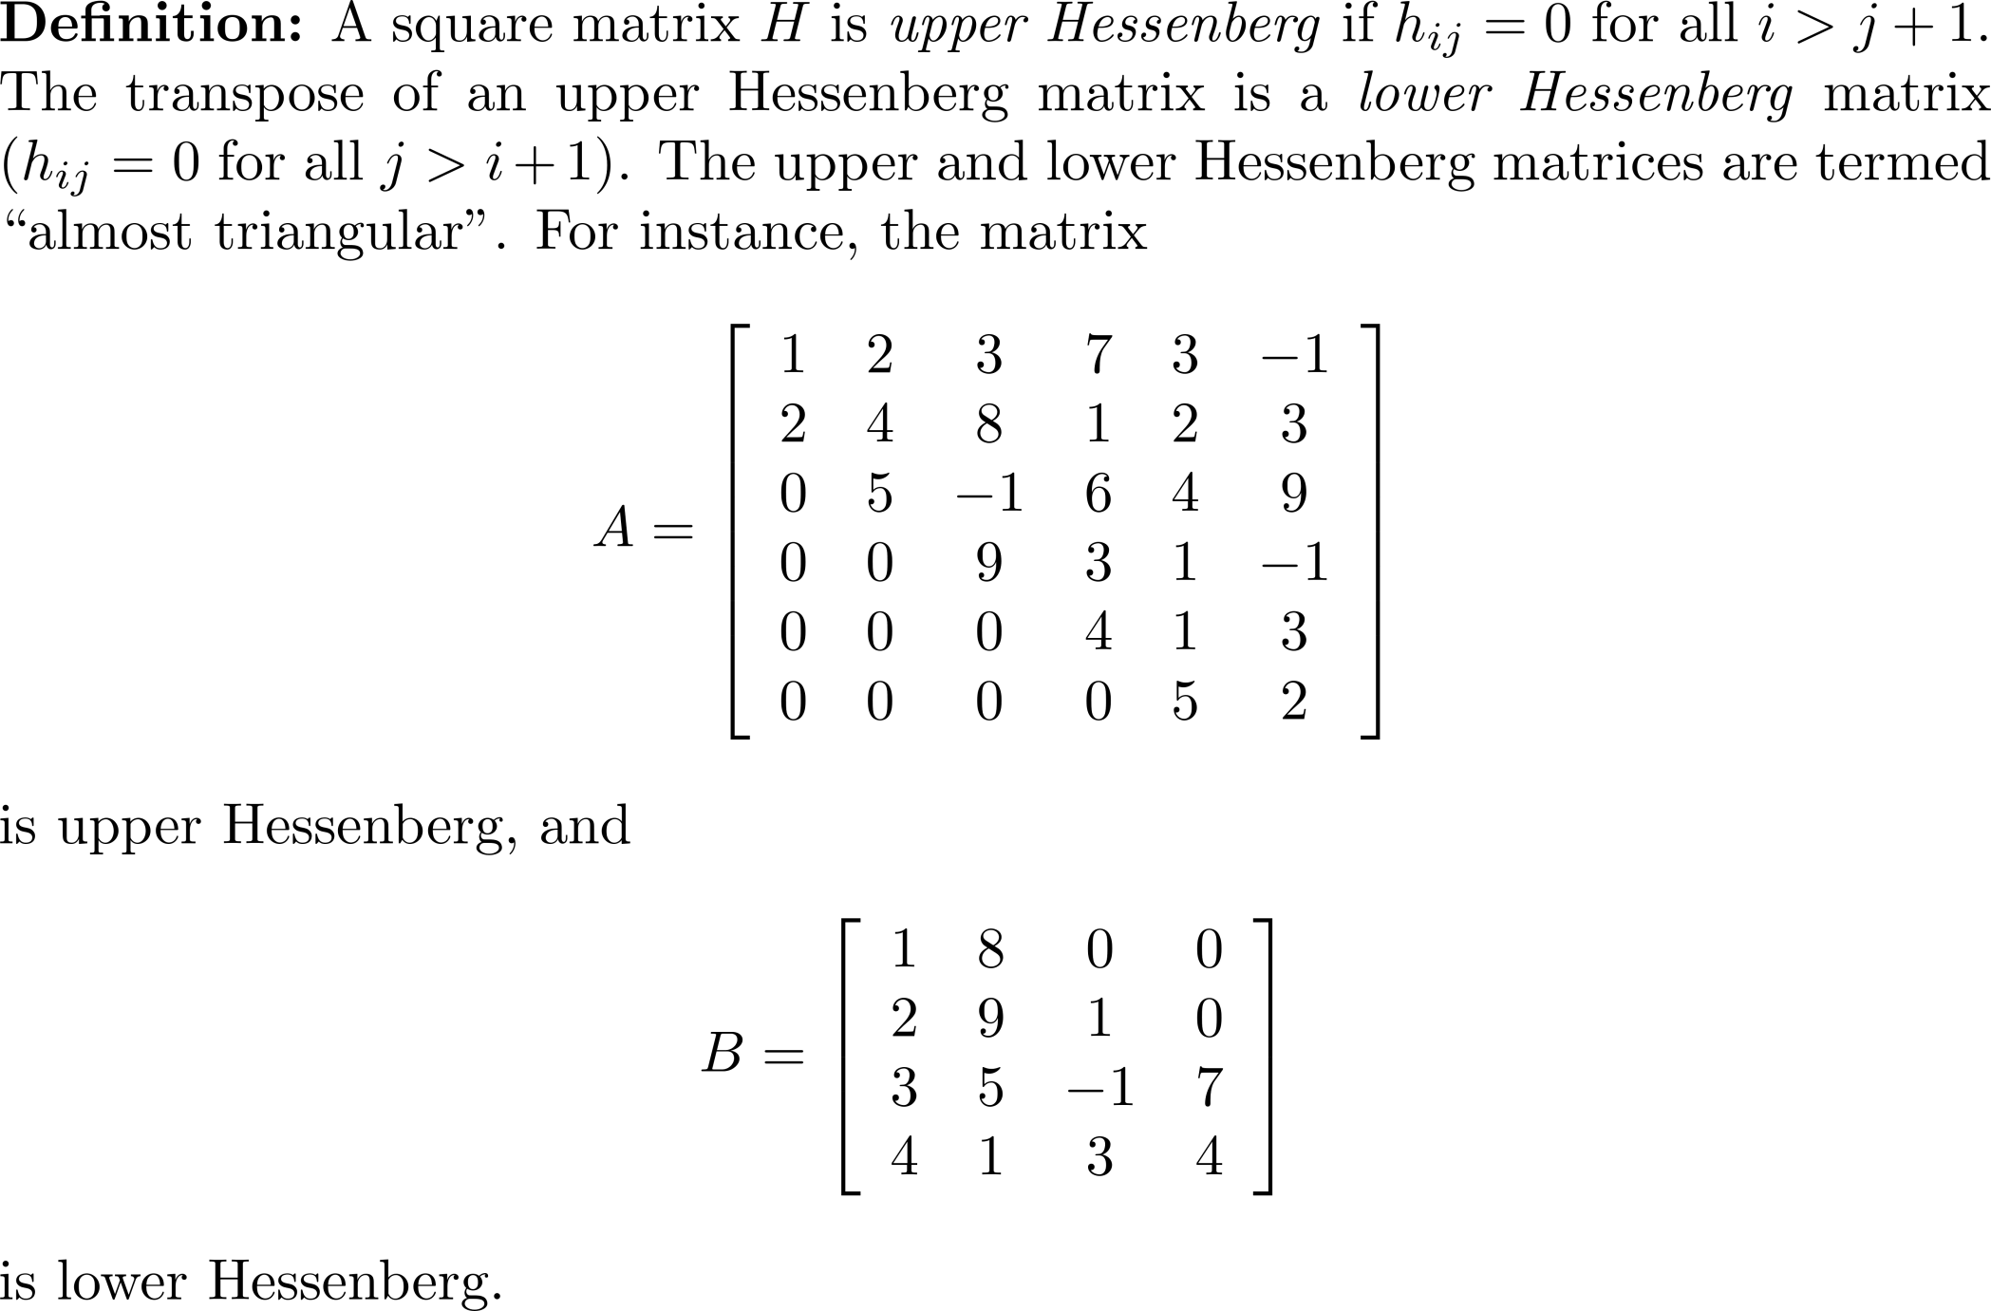
Hessenberg Form

Slide 45
Hessenberg Form
A general upper Hessenberg matrix:

Slide 46
Transformation to Upper Hessenberg Form
The basic QR iteration is not practical. If k = n, the iteration costs O(n⁴) flops. Instead,
Transform A into an upper Hessenberg matrix using orthogonal similarity transformations.
Make use of the simpler form of an upper Hessenberg matrix to quickly and accurately compute the eigenvalues.

Slide 47
Transformation to Upper Hessenberg Form
Use Householder reflections to zero-out the elements in each column 1, …, n-1 below the subdiagonal.
Use a similarity transformation of the form Using a transformation of the form will not maintain the same eigenvalues.

Slide 48
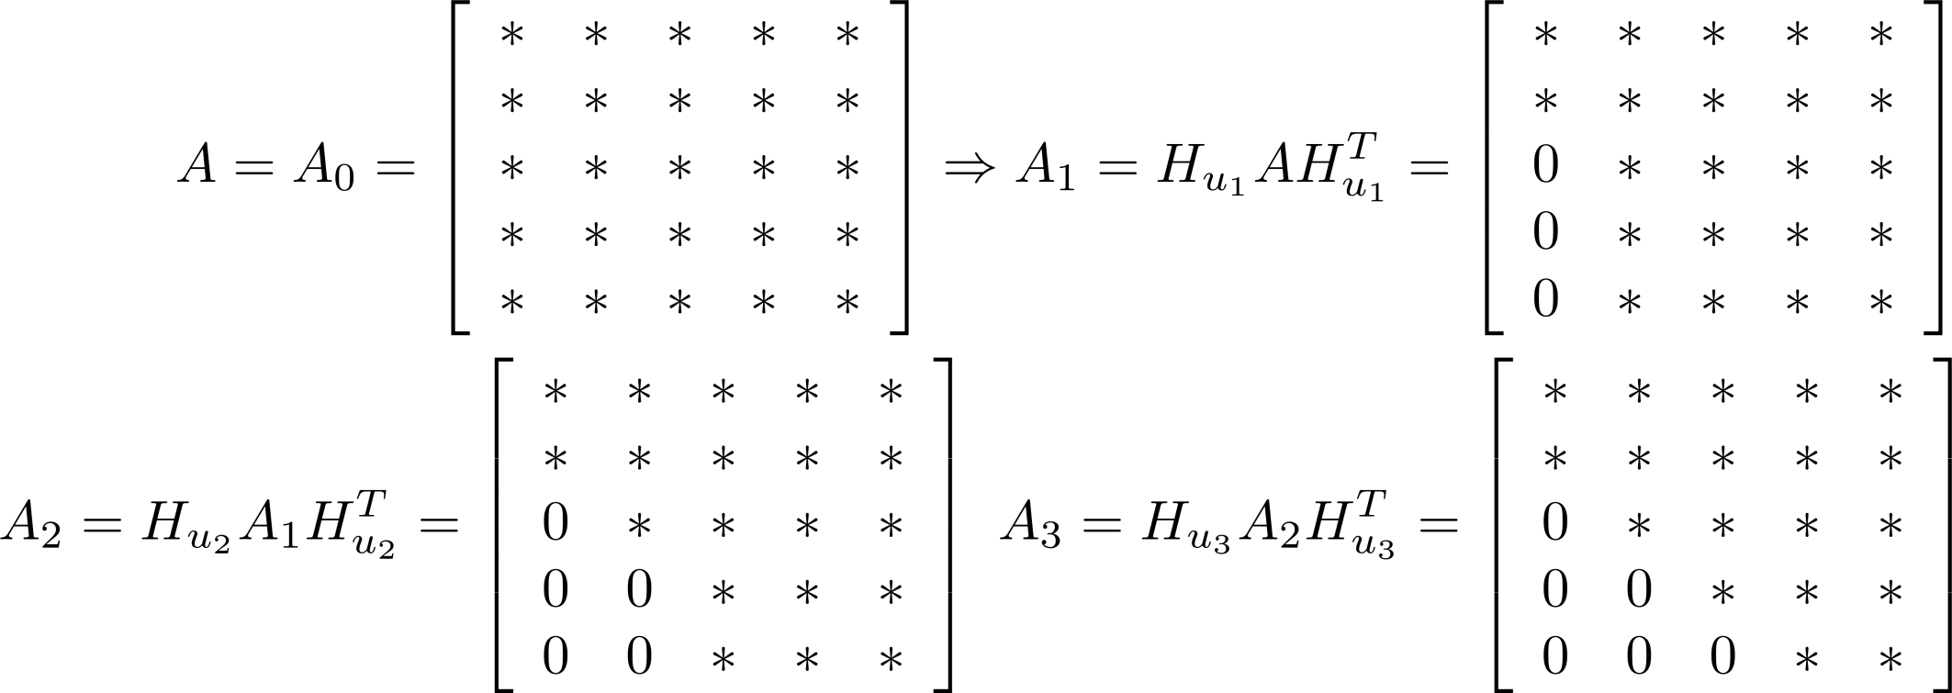
Transformation to Upper Hessenberg Form
The first three transformations for a 5 × 5 matrix.

Slide 49
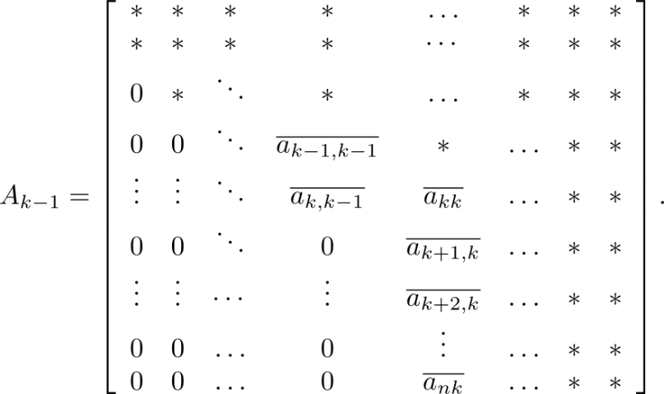
Transformation to Upper Hessenberg Form
After k-1 steps, we have
Let Compute the (n-k) × (n-k) Householder matrix so that

Slide 50
Transformation to Upper Hessenberg Form
Develop a matrix containing the submatrix such that when forming the elements become without destroying any work already done.
Choose , where I_{k} is the k × k identity matrix.
Form so we have a similarity transformation. Multiplying by maintains the zeros created by

Slide 51
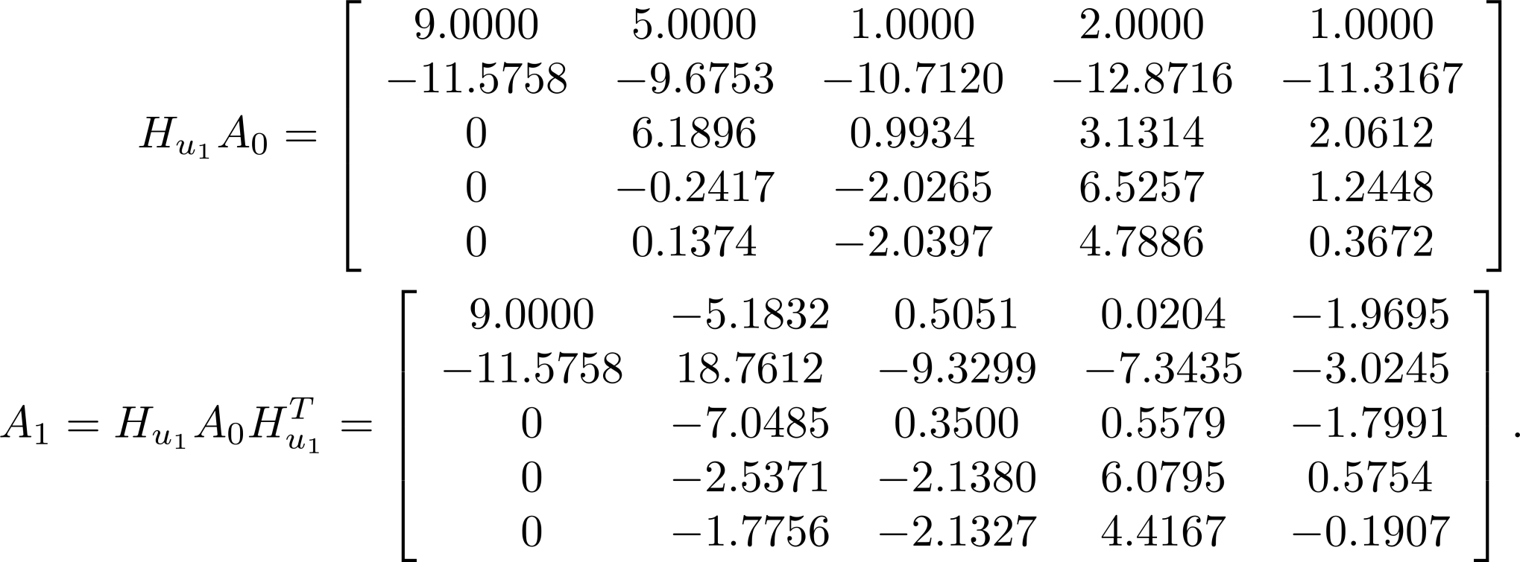
Example 7
Let
Affects rows 2:5 and columns 1:5
Affects rows 1:5 and columns 2:5

Slide 52
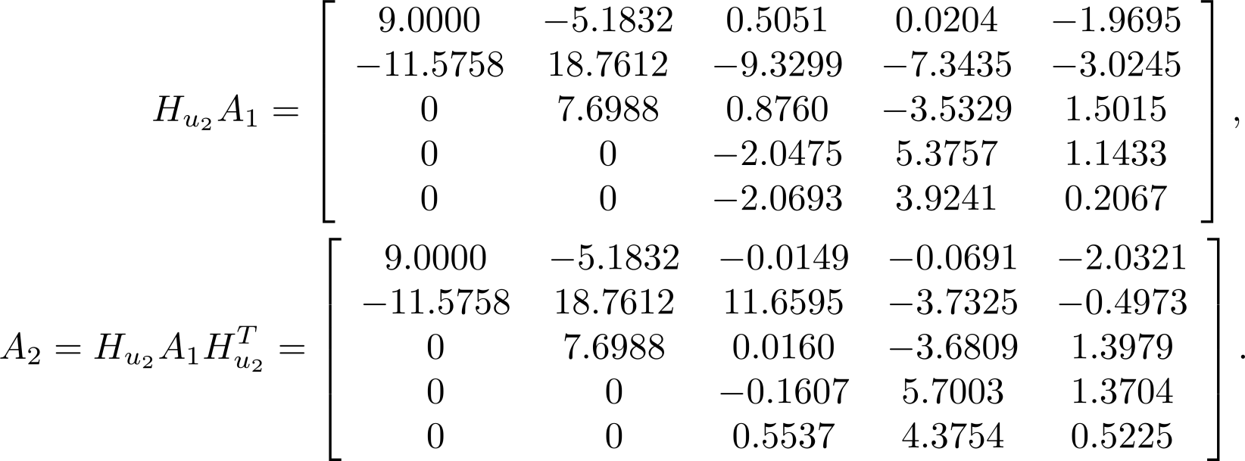
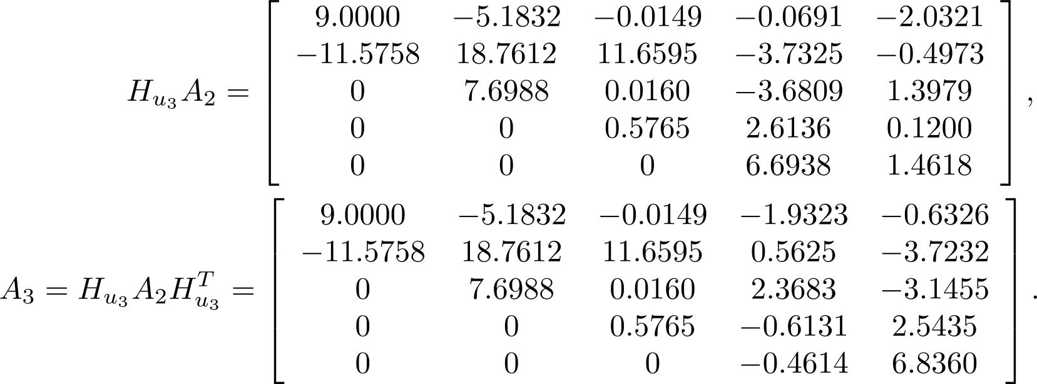
Example 7
Affects rows 3:5 and columns 2:5
Affects rows 1:5, columns 3:5
Affects rows 4:5 and columns 3:5
Affects rows 1:5, columns 4:5

Slide 53
Developing Algorithm hhess
In the example, the matrices are created explicitly. This is not efficient. The products are computed implicitly using submatrix operations.
affects rows k+1:n , columns k:n , and post multiplying by modifies rows 1:n , columns k+1:n. Using and perform the product using

Slide 54
Developing Algorithm hhess
The function [ u, β ] = house( A,i,j ) computes the vector u and the scalar β required to form a Householder reflection that will zero-out A( i+1:n,j ).

Slide 55
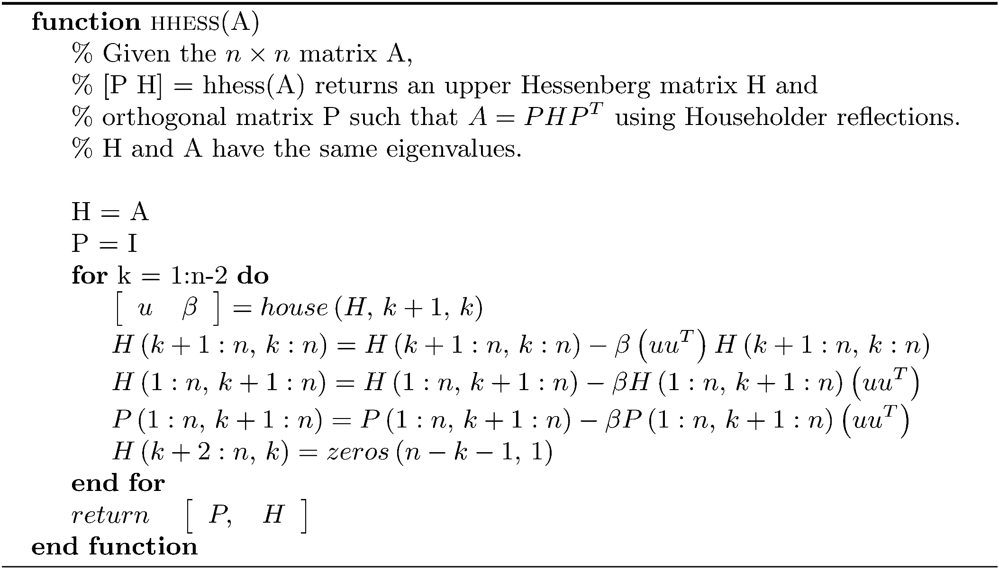
Algorithm hhess
Flop count: requires flops for the computation of H .
To build the orthogonal matrix P requires an additional flops.
The algorithm is stable.

Slide 56
Why is Converting First to Upper Hessenberg form Better?
Basic QR iteration requires O(n³) flops. n iterations of the algorithm requires O(n⁴) flops.
Reduction to upper Hessenberg form requires O(n³) flops, and it can be shown that the QR iteration requires O(n²) flops, making the algorithm O(n³) instead of O(n⁴).

Slide 57
An Unreduced Upper Hessenberg Matrix
Reduced Hessenberg Matrix
View as The eigenvalues are those of H₁₁ and H₂₂.
If either of these submatrices has a zero on its subdiagonal,
split it into two submatrices, and so forth.

Slide 58
The Unshifted Upper Hessenberg Iteration
Transform matrix A into an upper Hessenberg matrix H having the same eigenvalues as A. Assume H is unreduced. Apply the basic QR iteration and transform H into an upper triangular matrix with the eigenvalues of A on its diagonal.

Slide 59
The Unshifted Upper Hessenberg Iteration
Apply the QR iteration to the whole matrix until
Repeat the process for the (n-1) × (n-1) submatrix. Continue until have a 2 × 2 matrix containing the final two eigenvalues.
Called deflation.
Computes the eigenvalues in order increasing magnitude.

Slide 60
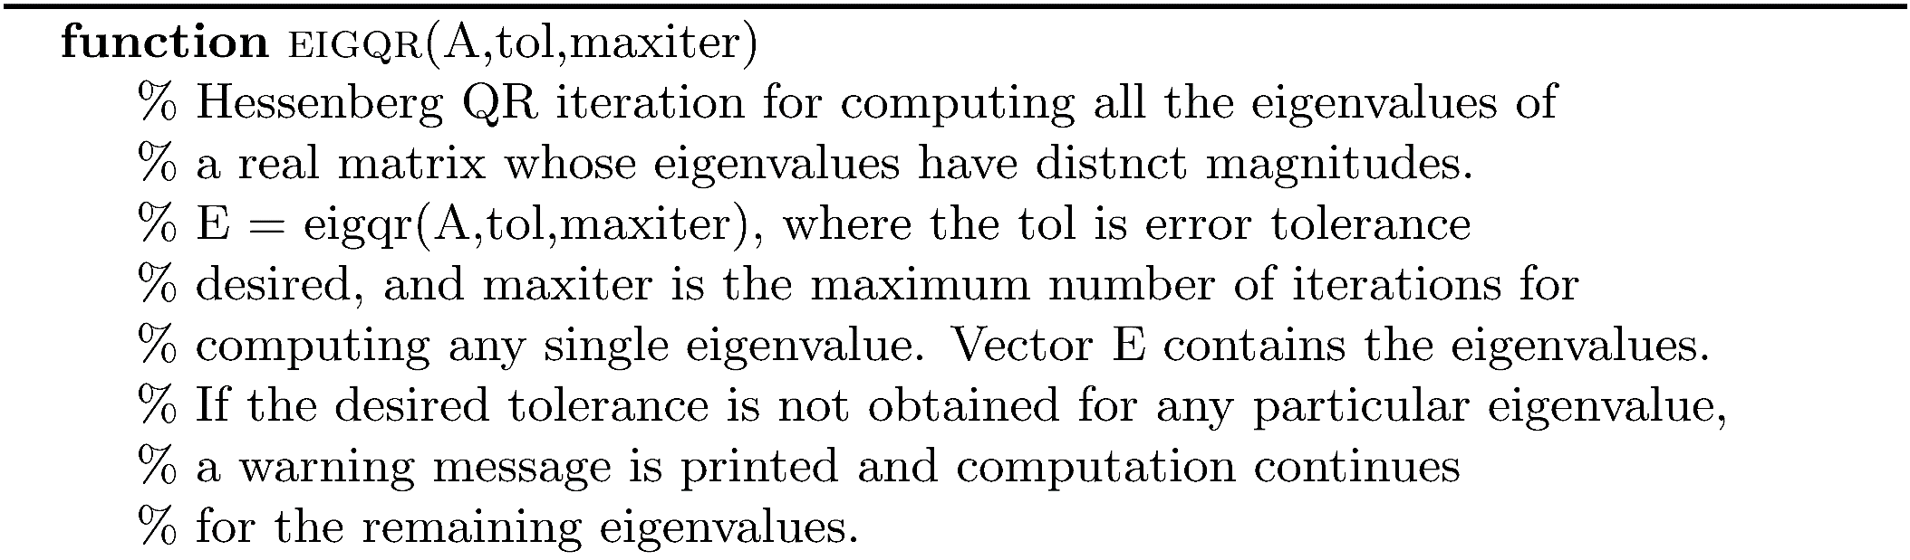
Algorithm eigqr

Slide 61
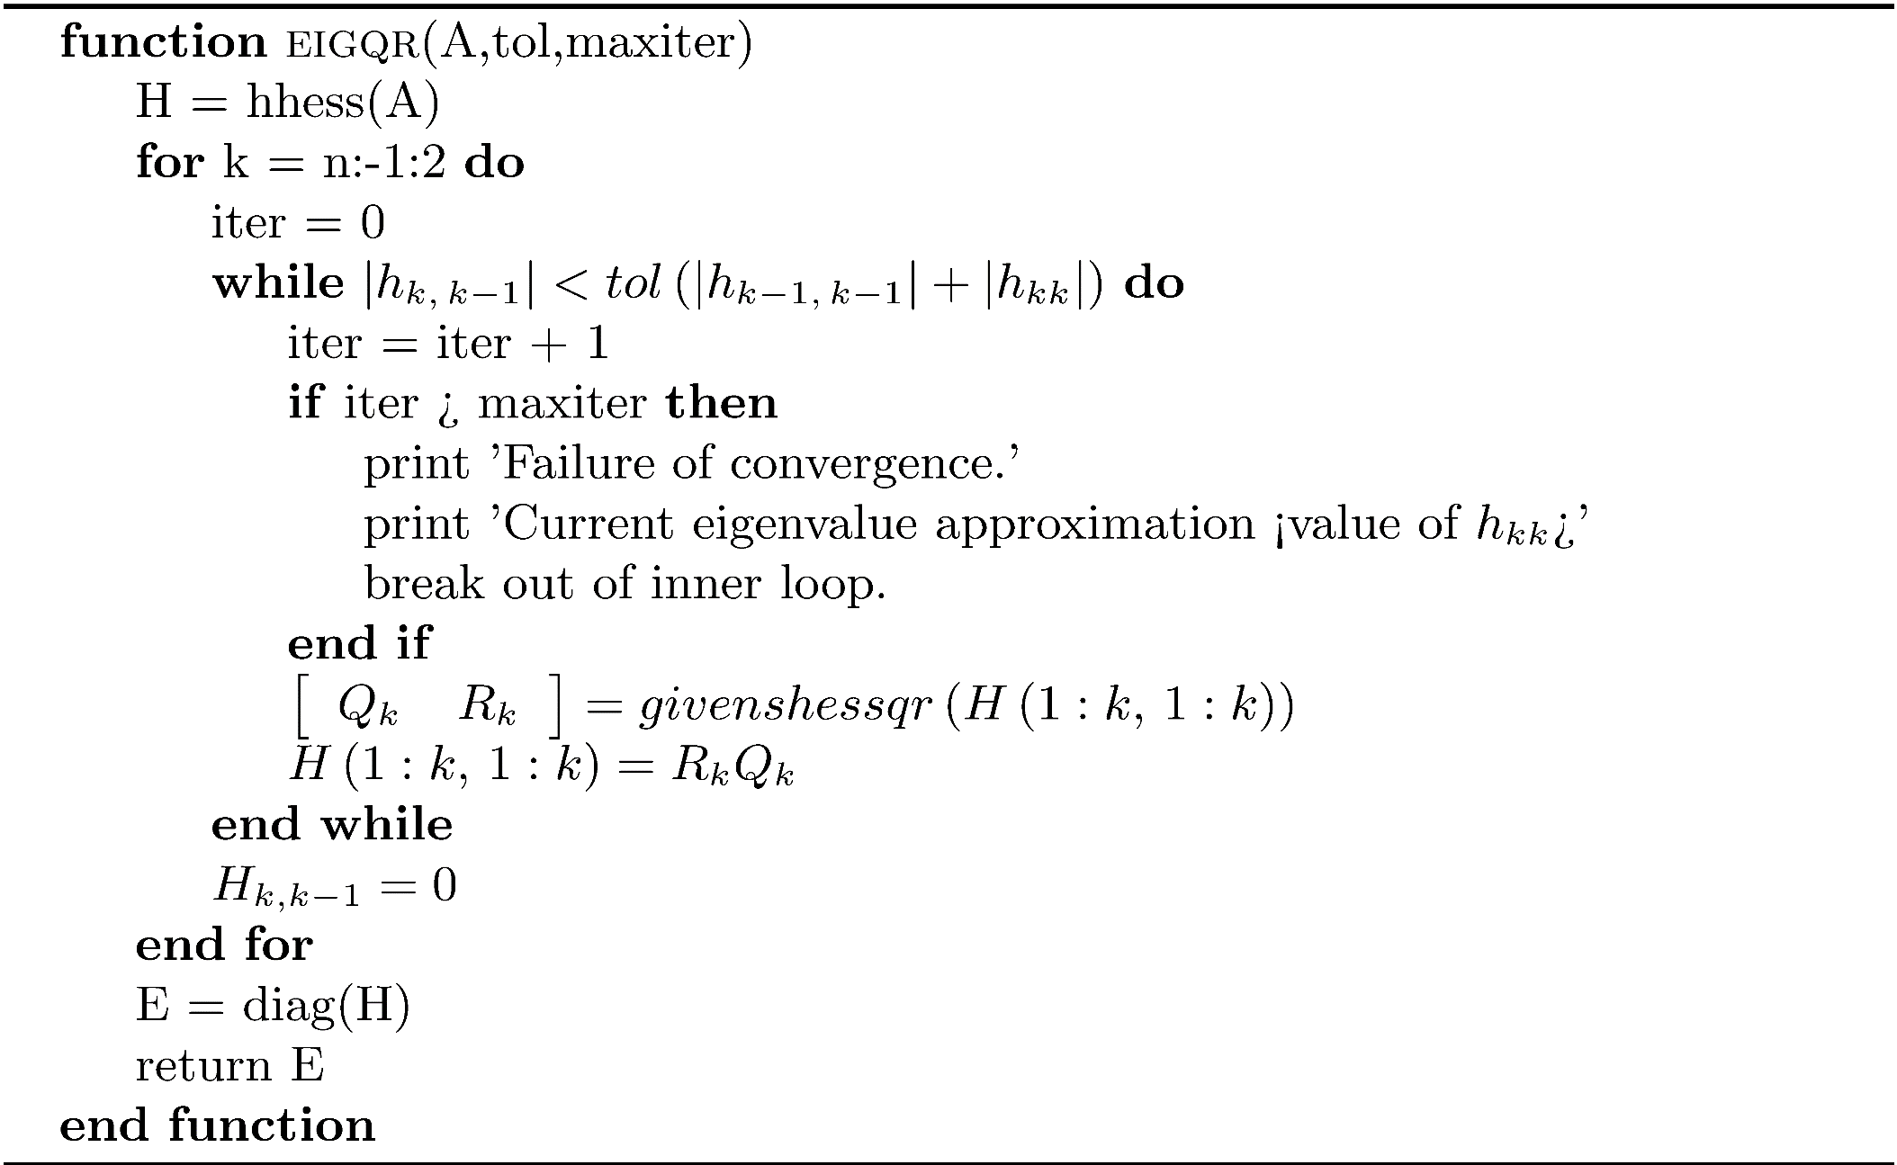
Algorithm eigqr
Implements the QR iteration of an upper Hessenberg matrix in O(n²) flops using Givens rotations.

Slide 62
Example 8
A =
-7 2 -1 7 -8
6 -5 -9 1 10
-4 3 -6 10 -10
1 4 9 -9 6
-7 5 -7 -1 7
>> E = eigqr(A,1.0e-14,100)
E =
-21.7464
13.0354
-9.8560
-3.7993
2.3663
>> eig(A)
ans =
-21.7464
13.0354
-9.8560
-3.7993
2.3663

Slide 63
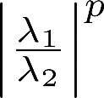
The Shifted Hessenberg QR Iteration
The rate at which the subdiagonal entries of the Hessenberg matrix converge to zero depends on the ratio , where λ₁, λ₂ , λ₁ < λ₂ are the two smallest eigenvalues in the current k × k submatrix. If λ₁ and λ₂ are close, convergence is slow.
Transform the problem of finding the eigenvalue to finding an eigenvalue of another matrix in which the eigenvalue is more isolated.

Slide 64
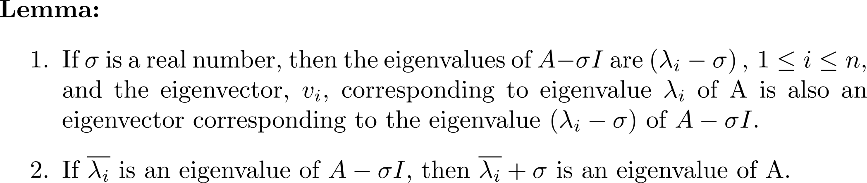
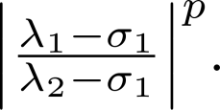
The Shifted Hessenberg QR Iteration
Shift Strategy
Let , where σ₁ is close to λ₁.
Compute the QR decomposition
Form
Rate of convergence to the smallest
eigenvalue of H_{k} - σ₁I depends on
For a nonsymmetric matrix, the Rayleigh quotient shift
is often used.
As the number of iterations
increase, H_{k}(k,k) approaches the
eigenvalue.

Slide 65
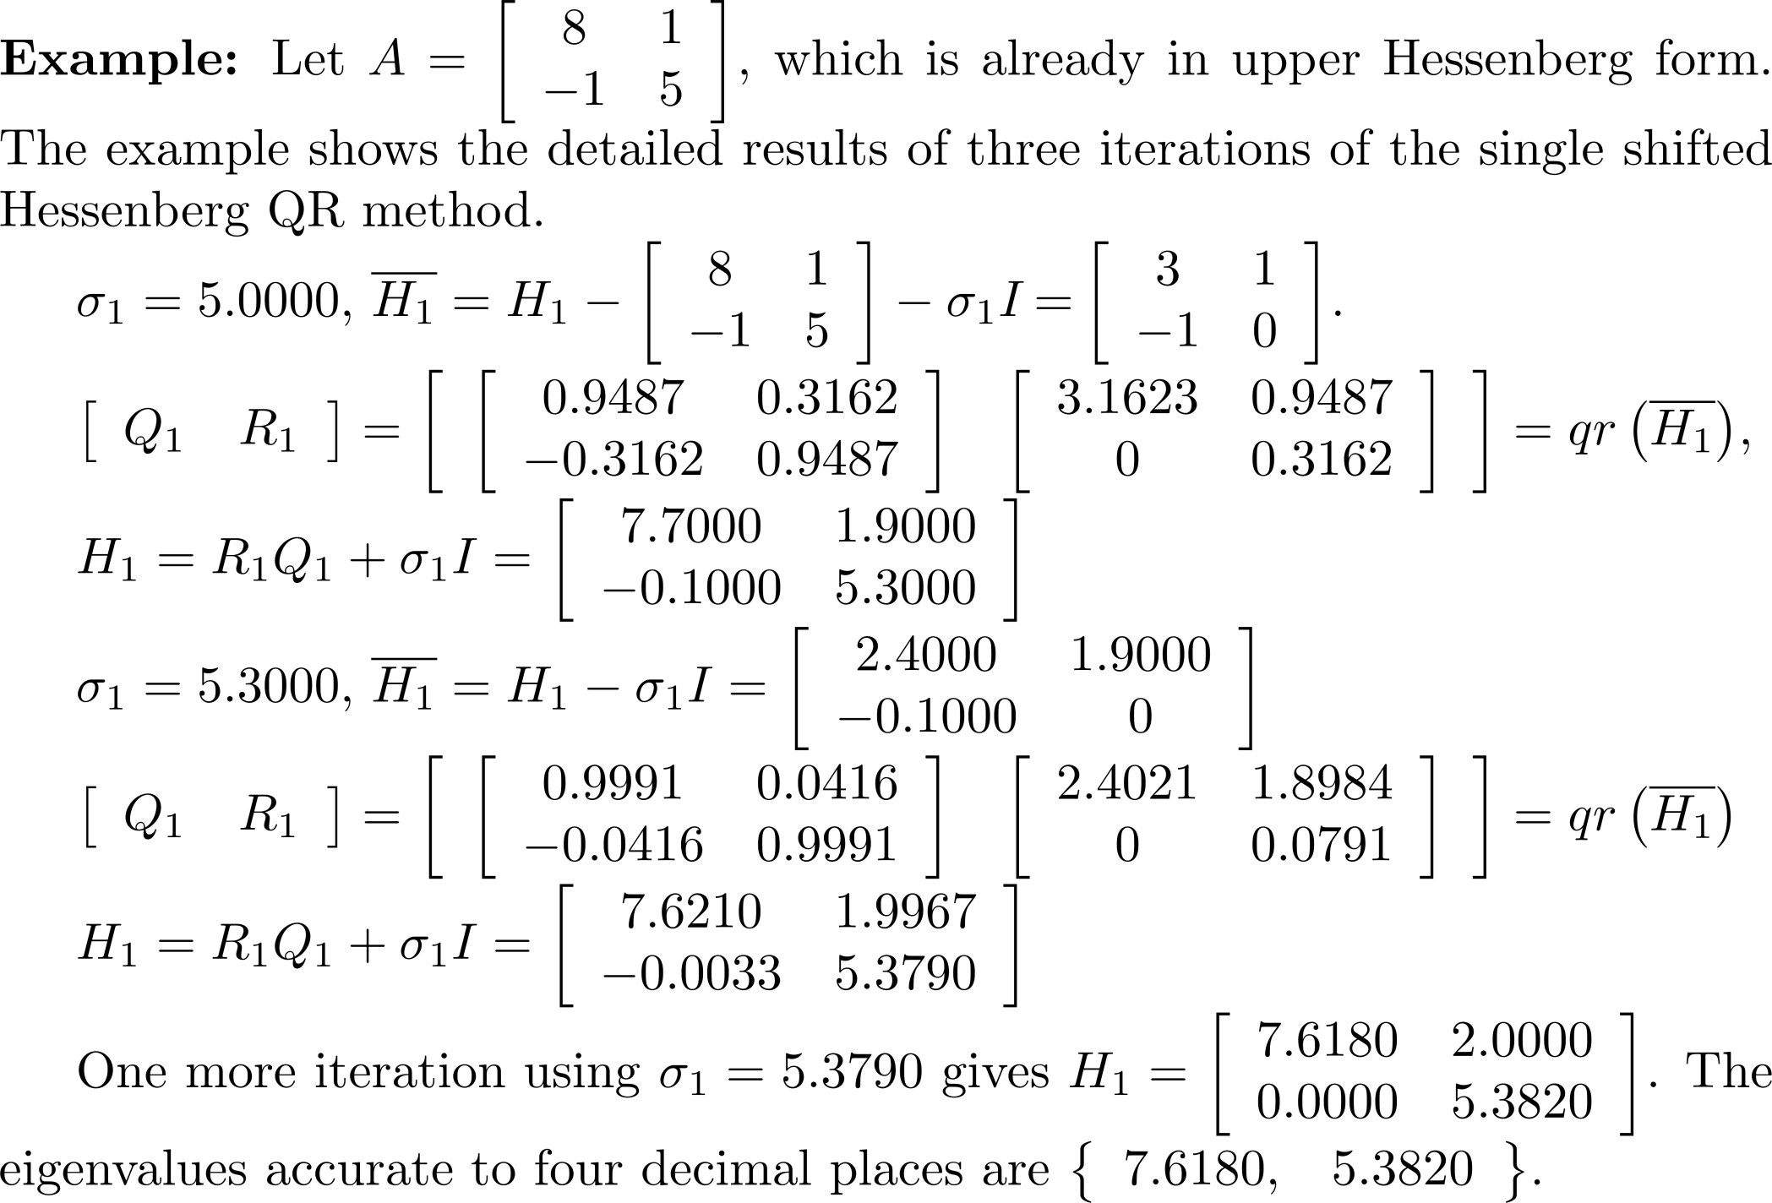
Example 9

Slide 66
Example 10
A =
-8.0968 -3.8052 -33.9255 0.6067 -35.6649
63.9675 27.4838 2.1950 25.0190 2.7456
-17.5150 -24.5449 -7.8090 -29.5136 -2.7604
-5.7240 3.9513 21.9983 6.3246 19.9437
-20.1560 12.3515 10.9748 5.4976 10.0474
>> E1 = eigqr(A,1.0e-14,100);
There are eigenvalues that did not converge. Consider using another method.
>> E1
E1 =
37.0000
-26.0000
8.0470
7.9030
1.0000
>> E = eigqrshift(A,1.0e-14,50);
>> E
E =
-26.0000
37.0000
1.0000
7.9500
8.0000
The eigenvalues of A are
1, 7.95, 8,-26, 37.
Close eigenvalues cause trouble.
Shifts take care of the problem.

Slide 67
Schur's Triangularization
Schur's triangularization is very useful theoretically because any square matrix can be factored, including singular ones.

Slide 68
Schur's Triangularization
If A is real and has complex eigenvalues, it is possible to find a real orthogonal matrix P if T is replaced by a real quasi-triangular matrix and obtain what is termed the real Schur form. T is a block upper triangular matrix of the form where the diagonal blocks are of size 1 × 1 or 2 × 2 . The 1 × 1 blocks contain the real eigenvalues of A , and the eigenvalues of the 2 × 2 diagonal blocks contain complex conjugate eigenvalues or two real eigenvalues.

Slide 69
Example 11
>> A = randn(5,5)
A =
-0.2725 -0.3538 0.0335 0.0229 -0.9792
1.0984 -0.8236 -1.3337 -0.2620 -1.1564
-0.2779 -1.5771 1.1275 -1.7502 -0.5336
0.7015 0.5080 0.3502 -0.2857 -2.0026
-2.0518 0.2820 -0.2991 -0.8314 0.9642
>> [P,T] = schur(A);
>> T
T =
2.1971 0.4337 0.4078 -1.8622 0.1656
-1.2298 2.1971 -0.1790 0.0162 -0.9912
0 0 -1.1241 -1.7340 0.0631
0 0 0.3392 -1.1241 -0.7946
0 0 0 0 -1.4360
>> eig(A)
ans =
2.1971 + 0.7303i
2.1971 - 0.7303i
-1.1241 + 0.7669i
-1.1241 - 0.7669i
-1.4360 + 0.0000i
>> eig(T(1:2,1:2))
ans =
2.1971 + 0.7303i
2.1971 - 0.7303i
>> eig(T(3:4,3:4))
ans =
-1.1241 + 0.7669i
-1.1241 - 0.7669i

Slide 70
The Francis Algorithm (Implicit QR Algorithm)
First step: transformation to upper Hessenberg form using orthogonality transformations.
Second step: transforms the upper Hessenberg matrix to upper triangular form by using a succession of orthogonal similarity transformations rather than directly using shifts and the QR decomposition.
Two forms: single shift for matrices with real eigenvalues (symmetric matrices) and double shift for finding real and complex eigenvalues.

Slide 71
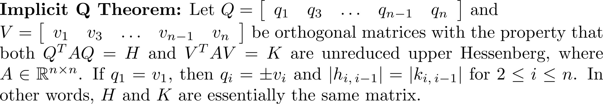
The Francis Algorithm
Single shift: These relationships give
The trick is to form H₁ without having to directly compute Q₁ from the QR decomposition.
Relies on the Implicit Q Theorem.

Slide 72
Single Shift Francis Algorithm
Begin with an upper Hessenberg matrix H and single shift σ. Apply orthogonal similarity transformations that chase a bulge (destroys the upper Hessenberg form) down the main diagonal until the bulge disappears below the matrix. Repeat until the sequence gets close enough to the eigenvalue in the lower-right hand corner of the current submatrix.

Slide 73
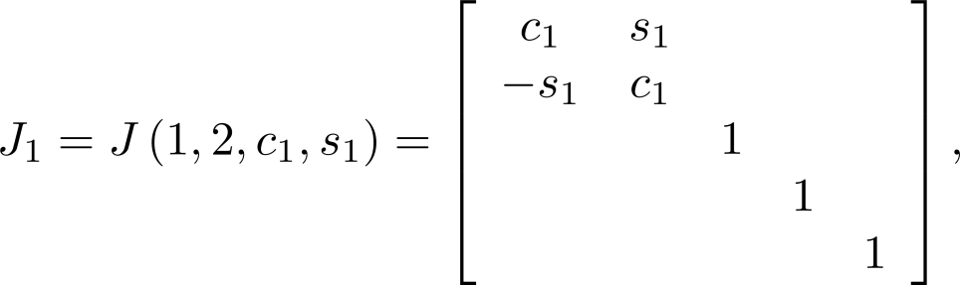
Demonstration of the Single Shift Algorithm for a 5 × 5 Matrix
Step 1: implicitly build where c and s are determined from the vector
and form
Bulge - disturbs upper
Hessenberg form.

Slide 74
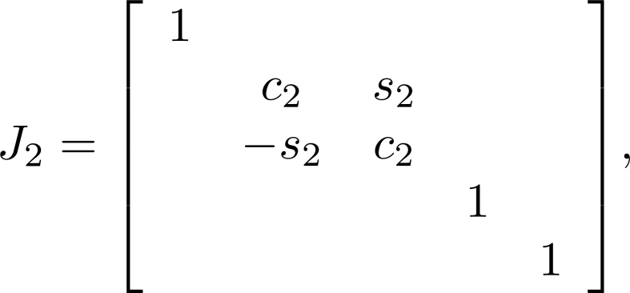
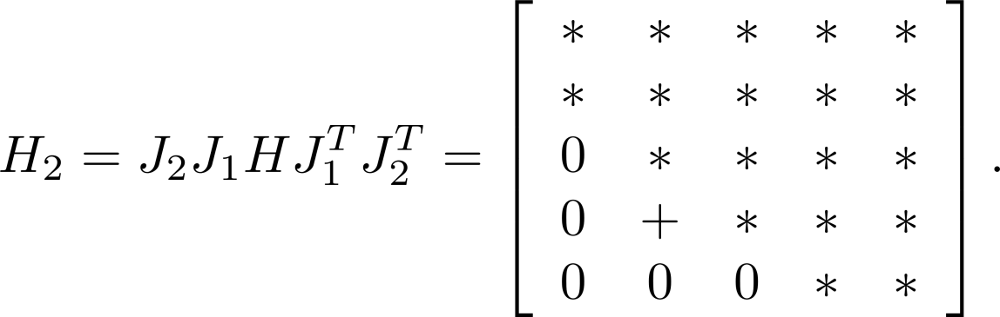
Demonstration of the Single Shift Algorithm for a 5 × 5 Matrix
Step 2: compute c₂ and s₂ from H₁(2,1) and H1(3,1). Build and form
Bulge - disturbs upper
Hessenberg form.

Slide 75
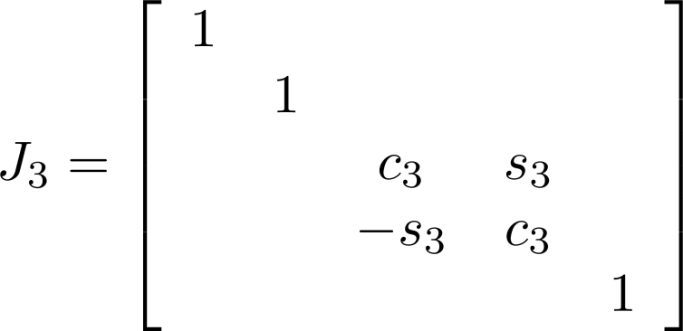
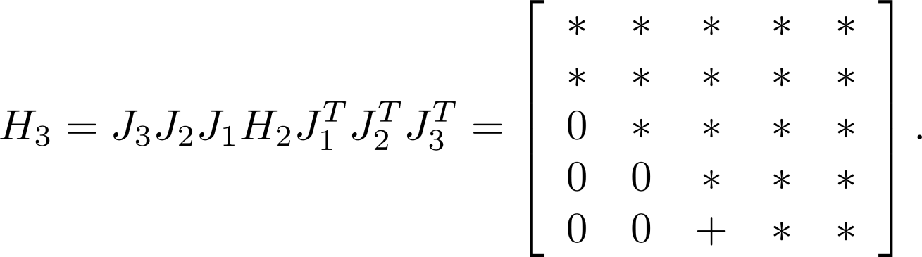
Demonstration of the Single Shift Algorithm for a 5 × 5 Matrix
Step 3: compute c₃ and s₃ from the elements H₂(3,2) and H₂(4,2). Build and form
Bulge - disturbs upper
Hessenberg form.

Slide 76
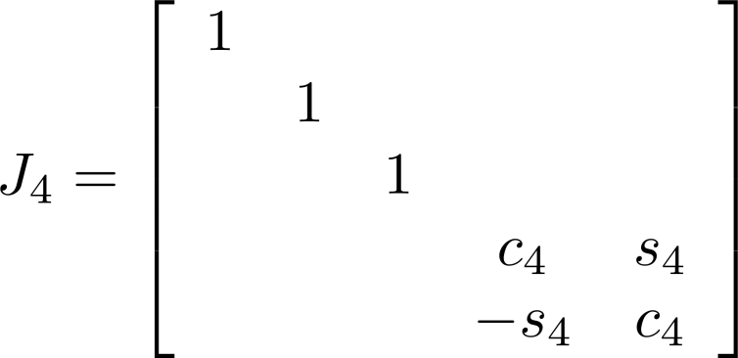
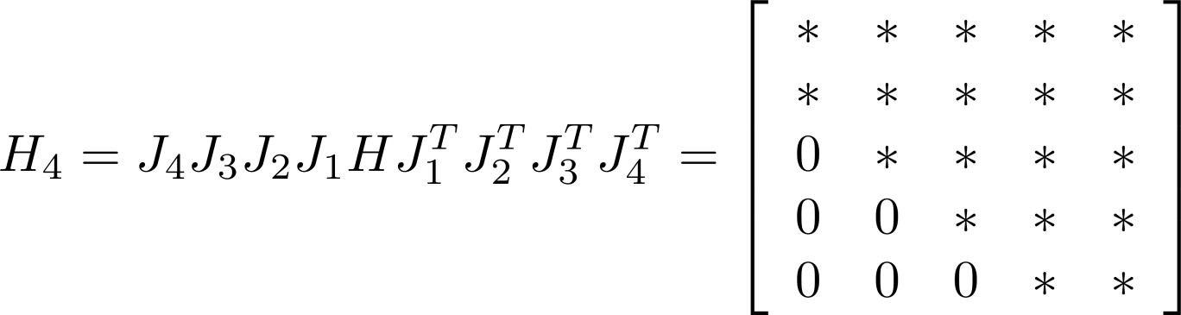
Demonstration of the Single Shift Algorithm for a 5 × 5 Matrix
Step 4: compute c₄ and s₄ from the elements H₃(4,3) and H₃(5,3). Build and form

Slide 77
Demonstration of the Single Shift Algorithm for a 5 × 5 Matrix
Let and K has the form and the first column is the same as when Givens rotations are used to compute the QR decomposition of H-σ I . Except for signs, K is the matrix we would obtain by doing an explicit shift.

Slide 78
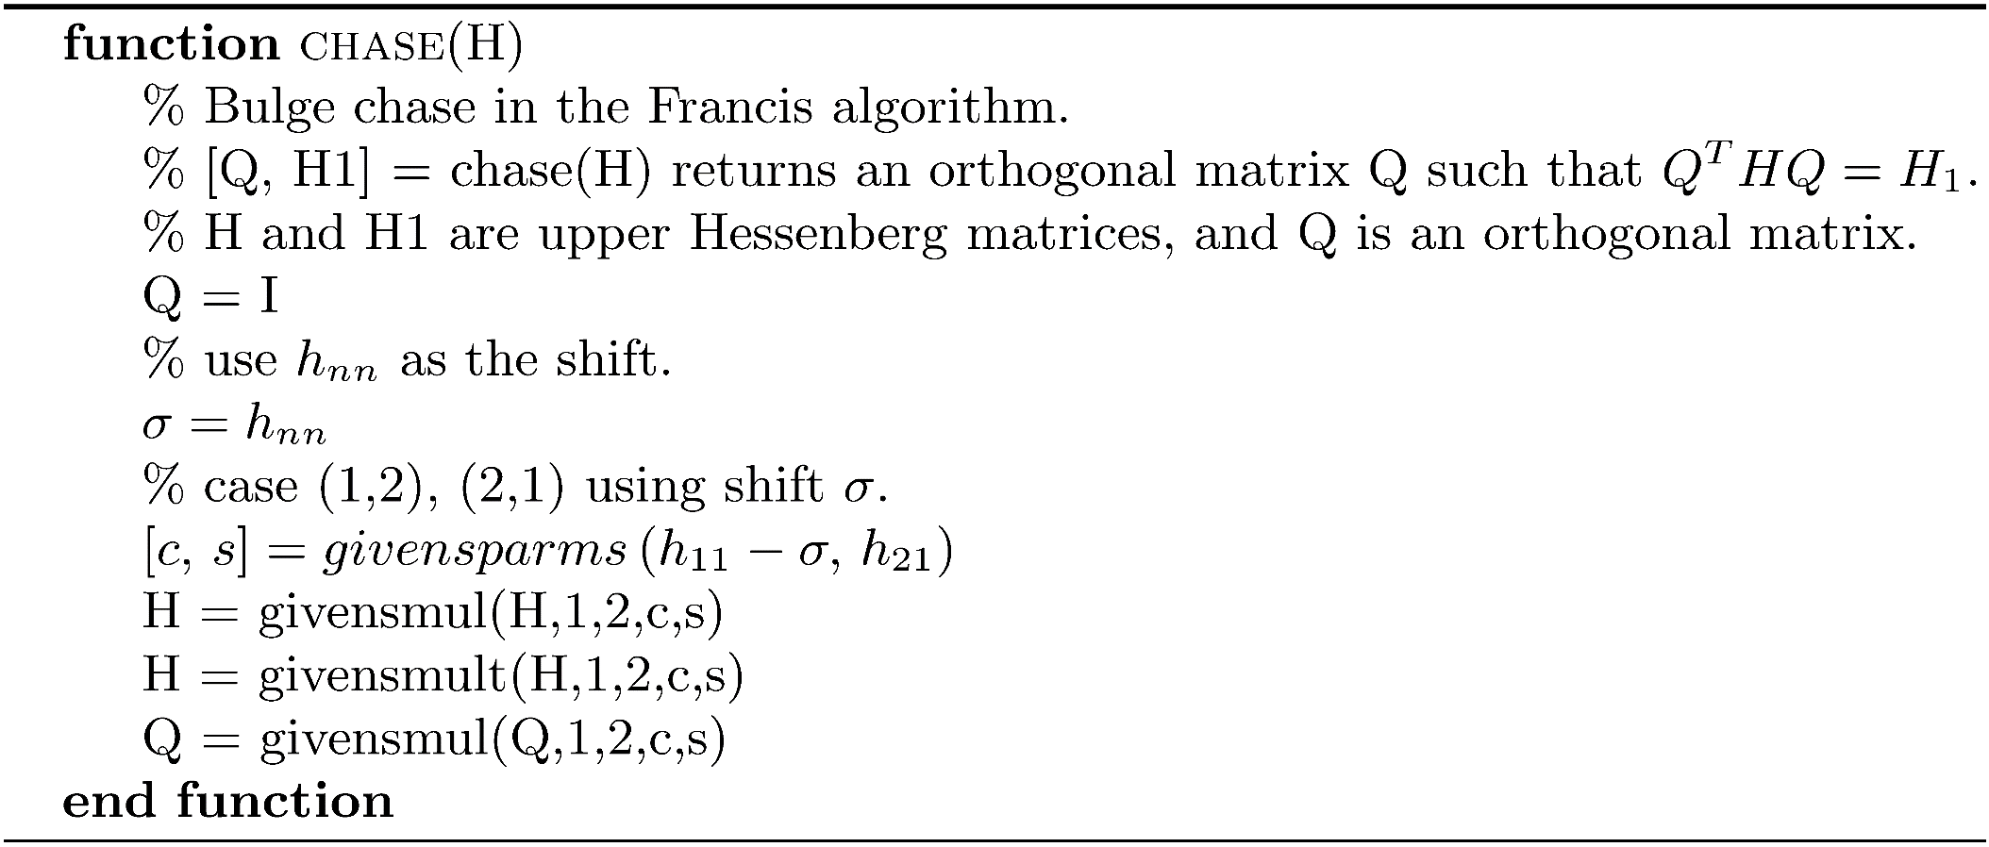
Algorithm chase

Slide 79
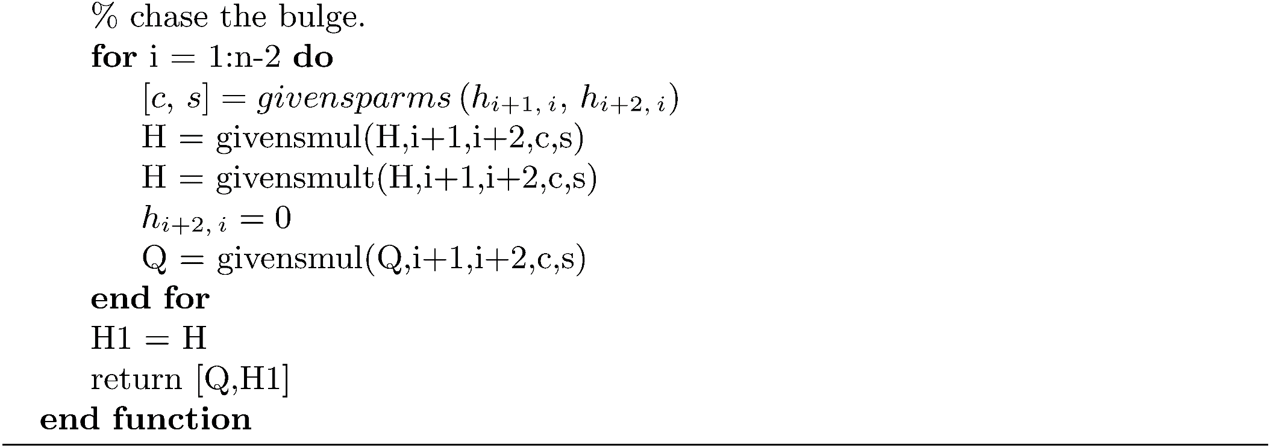
Algorithm chase
NOTE: givensmult(H,i,j,c,s) computes

Slide 80
Francis Iteration of Degree Two
When computing a complex conjugate pair of eigenvalues, it is desirable to avoid complex arithmetic, since complex arithmetic requires about four times as many flops. A double-shift computes both eigenvalues using only real arithmetic.
Use the eigenvalues of the 2 × 2 lower right-hand corner submatrix as the shifts.

Slide 81
Francis Iteration of Degree Two
Perform a shift first by σ₁ and then by σ₂ as follows:
After some algebra,
A* is the conjugate
transpose of A.
Q₁Q₂ is real. H₂ is real.

Slide 82
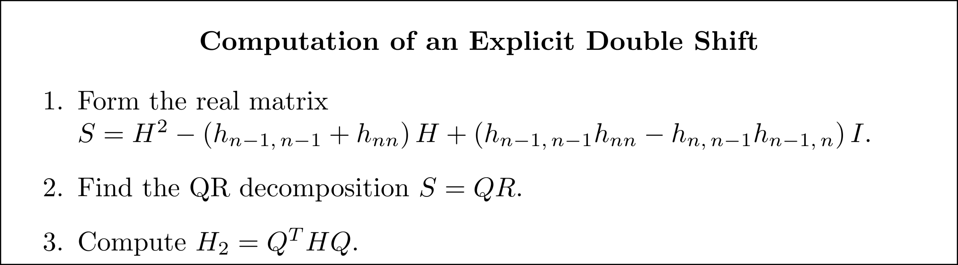
Francis Iteration of Degree Two
Some analysis gives the algorithm for an explicit double shift.
Costs O(n³) flops. Too slow for repeated execution.
We want to compute the upper Hessenberg matrix H₂ = Q^{T}HQ without first performing a QR decomposition of S . By using an implicit process, we can compute a double shift using only O(n²) flops.

Slide 83
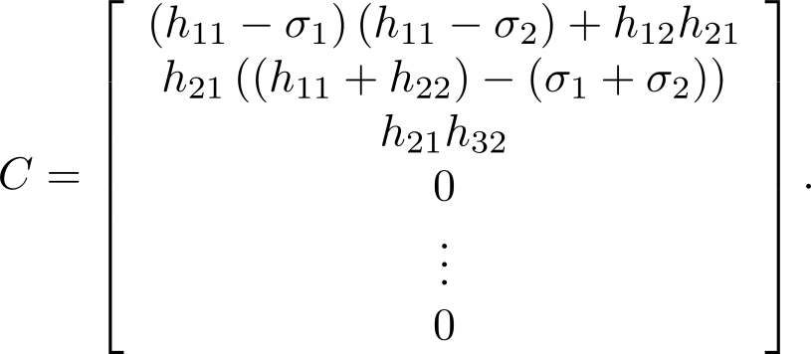
Francis Iteration of Degree Two
We have and The Implicit Q Theorem says that we essentially get H₂ using any orthogonal similarity transformation Z^{T}HZ provided that Z^{T}HZ is upper Hessenberg, and Q and Z have the same first column, or Qe₁ = Ze₁.
The first column of S is

Slide 84
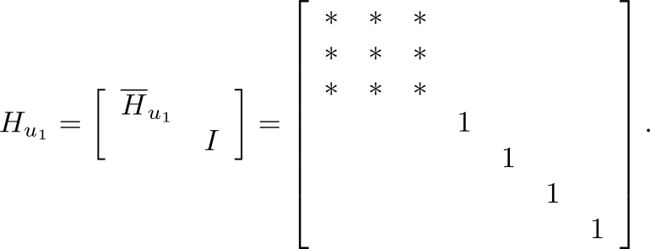
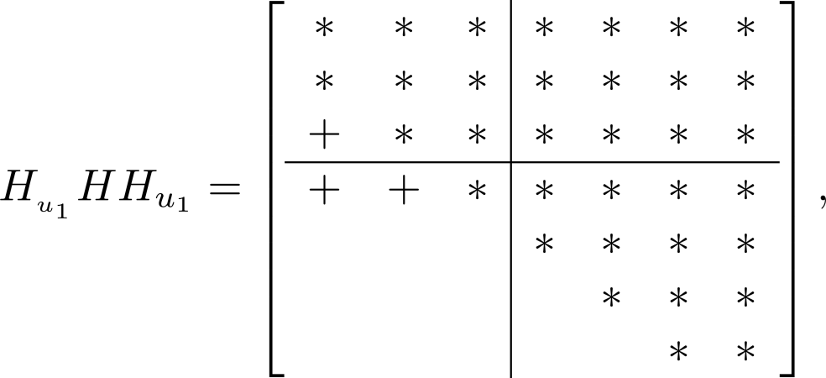
The Sequence of Orthogonal Transformations in the Implicit Double Shift (7 × 7) example)
Construct the 3 × 3 Householder reflection that zeros-out and in the first column of S. Form the 7 × 7 reflection and compute
2 × 2 bulge.

Slide 85
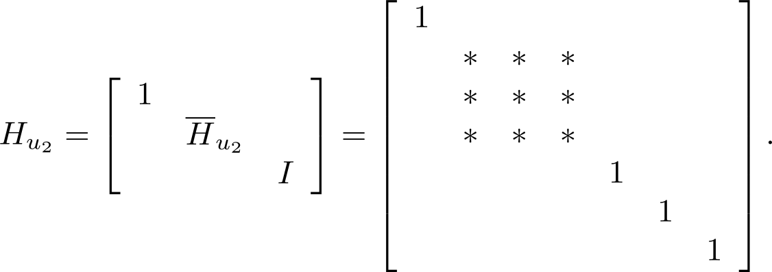
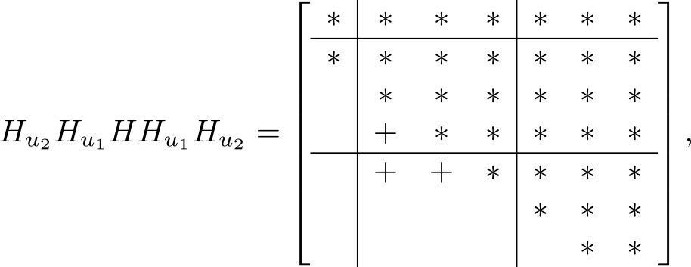
The Sequence of Orthogonal Transformations in the Implicit Double Shift (7 × 7) example)
Chase the bulge down and out to the right.
Zero-out the elements at indices (3,1) and (4,1).
Bulge

Slide 86
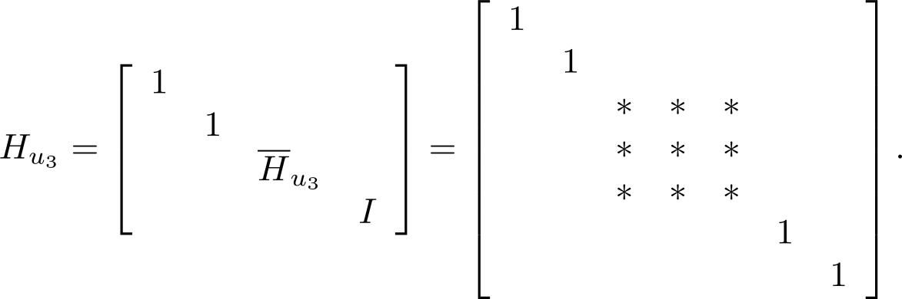
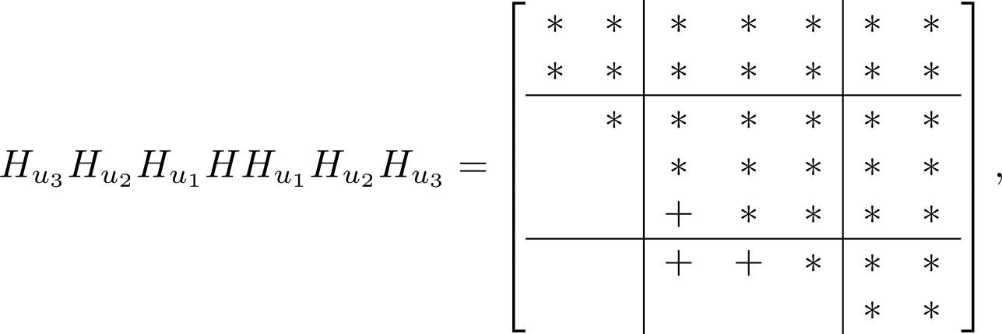
The Sequence of Orthogonal Transformations in the Implicit Double Shift (7 × 7) example
Zero-out the elements at indices (4,2) and (5,2).
Bulge

Slide 87
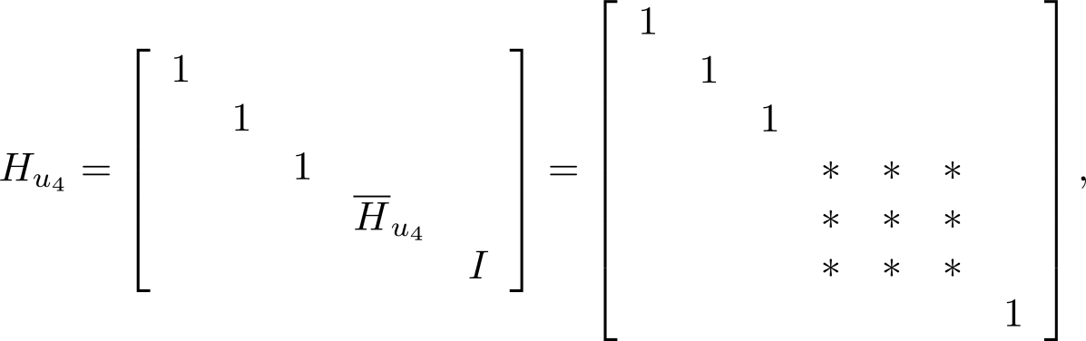
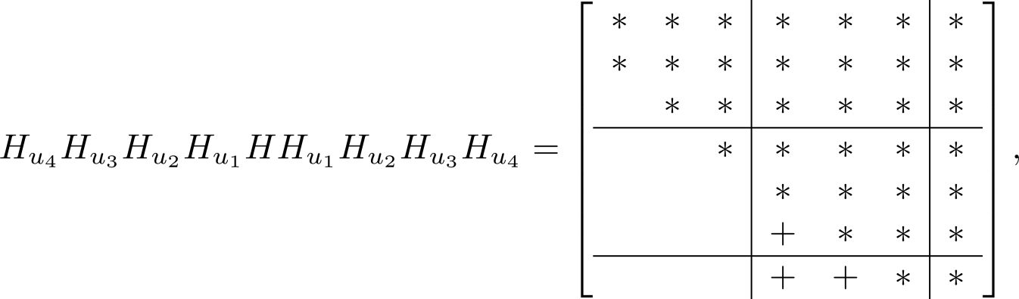
The Sequence of Orthogonal Transformations in the Implicit Double Shift (7 × 7) example
Zero-out the elements at indices (5,3) and (6,3).
Bulge

Slide 88
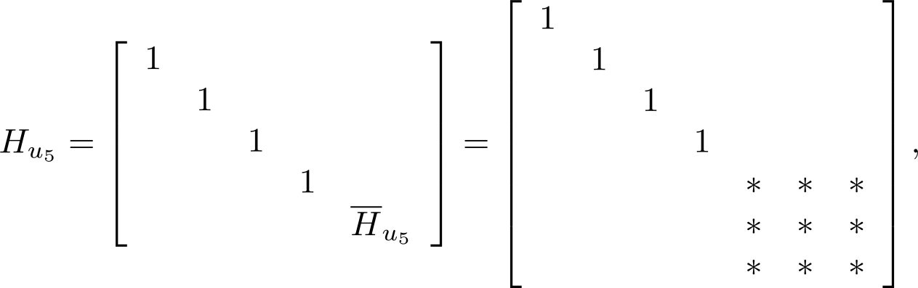
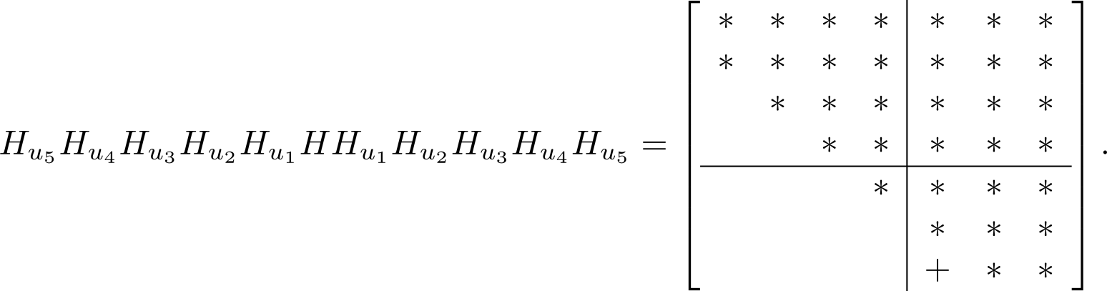
The Sequence of Orthogonal Transformations in the Implicit Double Shift (7 × 7) example
Zero-out the elements at indices (6,4) and (7,4).

Slide 89
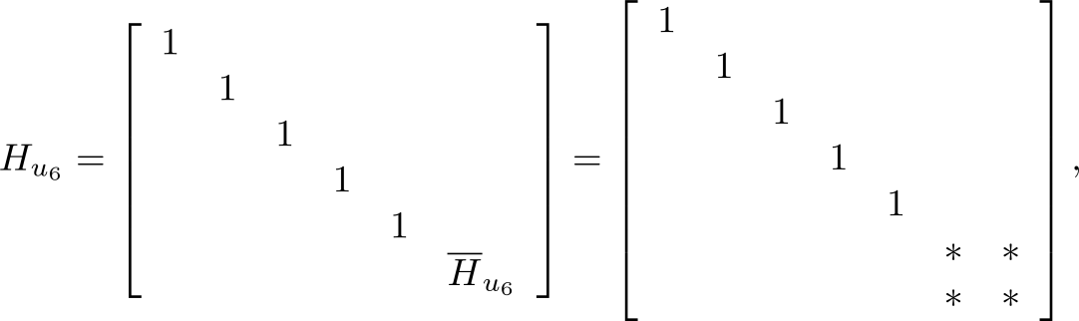
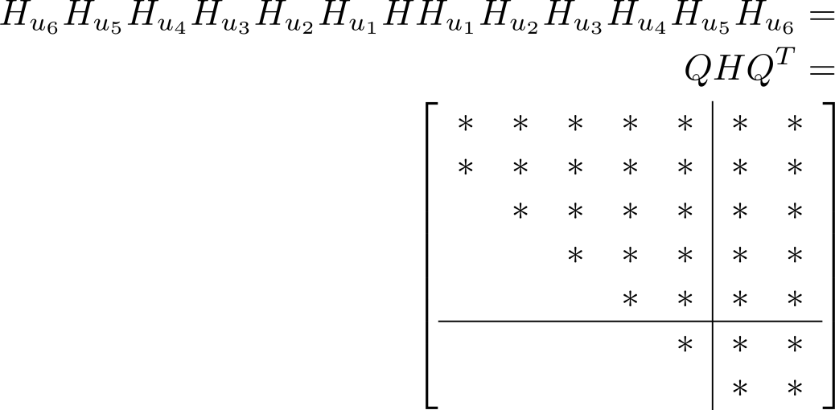
The Sequence of Orthogonal Transformations in the Implicit Double Shift (7 × 7 example)
Zero-out the element at index (7,5) using a 2 × 2 reflection.
Upper Hessenberg form
By the Implicit Q Theorem,
Q^{T} is a matrix such that
H₂ = QHQ^{T}.

Slide 90
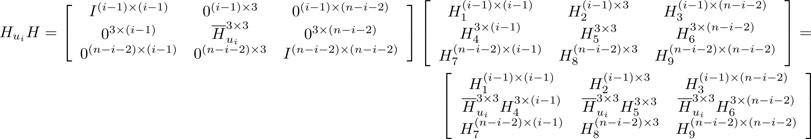
Introduction to Algorithm impdsqr
Use block matrix operations so we don't have to build the Householder matrices.
Only affects rows i:i+2 and columns 1:n.
The product affects only rows 1:n and columns i:i+2 .
The final preproduct using a 2 × 2 Householder reflection
involves rows n-1:n and columns 1:n , followed by the postproduct
using rows 1:n and columns n-1:n.

Slide 91

Implicit Double Shift QR

Slide 92

Implicit Double Shift QR

Slide 93

Implicit Double Shift QR

Slide 94

Computing Eigenvectors
Given an eigenvalue , find a corresponding eigenvector.
Let B = (A - I)⁻¹. It can be shown that the eigenvectors of B and A are the same and that the inverse iteration applied to B converges to an eigenvector of A.

Slide 95
Hessenberg Inverse Iteration
Apply inverse iteration to find eigenvectors of the upper Hessenberg matrix. Solve the linear systems in O(n²) running time by taking advantage of the upper Hessenberg structure.
After reduction to upper Hessenberg form, where P is an orthogonal matrix. If u is an eigenvector of H corresponding to eigenvalue λ, Pu is an eigenvector of A.

Slide 96

Algorithm eigvechess

Slide 97



Inverse Iteration to Find Eigenvector of an Upper Hessenberg Matrix (concluded)
$$H$$
$$H$$
luhess forms the LU decomposition of H-σI in O(n²) flops.

Slide 98
Computing Both Eigenvalues and Their Corresponding Eigenvectors
After reduction to upper Hessenberg form, apply the Francis iteration of degree two to compute the eigenvalues, followed by the use of the shifted inverse Hessenberg iteration to determine an eigenvector corresponding to each eigenvalue.

Slide 99

eigb

Slide 100
Example 11
Generate a 75 × 75 random real matrix (most likely will have complex eigenvalues) and use eigb to compute its eigenvalues and eigenvectors. A function, checkeigb, in the software distribution computes the minimum and maximum values of

Slide 101
Example 11
>> A = randn(75,75);
>> [V D] = eigb(A,1.0e-12);
>> [min max] = checkeigb(A,V,D)
min =
7.4402e-15
max =
4.3307e-12
>> E = diag(D);
>> E(1:6)
ans =
0.25436 + 0i
0.62739 + 0i
1.2352 + 1.8955i
1.2352 - 1.8955i
2.3356 + 0.90619i
2.3356 - 0.90619i
>> E(70:75)
ans =
6.8625 - 1.1636i
2.7378 + 7.5951i
2.7378 - 7.5951i
7.2777 + 5.6828i
7.2777 - 5.6828i
9.4579 + 0i

Slide 102


Sensitivity of Eigenvalues to Perturbations

Slide 103

Example 12

Slide 104


Sensitivity of Eigenvalues to Perturbations

Slide 105

Compute Eigenvalue Condition Numbers

Slide 106
Example 13
>> load('E');
>> E
E =
-12.6807 53.2165 -26.7095 -3.8305 -1.6609
-3.1951 60.2393 -13.3461 29.4403 -6.4092
15.1690 27.9636 22.5165 -0.4758 -31.9504
48.1415 28.4751 -29.4659 9.0608 -53.4243
16.0254 49.6689 -36.9764 -49.1620 1.8641
>> [V,D] = eigb(E,1.0e-12,2200);
>> [min,max] = checkeigb(E,V,D)
min =
4.4631e-14
max =
1.3651e-05
>> eigcond(E)
ans =
1.0e+07 *
3.9259
3.9259
3.0811
3.0811
0.0000
E has eigenvalues λ₁ = 51, λ₂ = 52, λ₃ = 52, λ₄ = -37, λ₅ = -37
The multiple eigenvalues cause the high condition numbers.

Slide 107
Sensitivity of Eigenvectors
Perturbation analysis for eigenvectors is significantly more complex than that for eigenvalues.
The perturbation of a particular eigenvector, v_{i}, corresponding to eigenvalue, λ_{i} , is determined by the condition number of the eigenvectors λ_{k} ,k ≠ i and |λ_{i} - λ_{k}|,k ≠ i .
If the eigenvalues are well-separated and well-conditioned, then the eigenvectors will be well-conditioned. However, if there is a multiple eigenvalue or there is an eigenvalue close to another eigenvalue, then there will be some ill-conditioned eigenvectors

